Slide 1
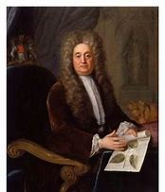
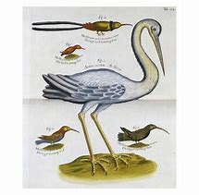
Hans Sloane and his birds

Slide 2
The only difference between a spiritual bird and a natural bird.
of some angel represented outside of the angel as a bird, and that it would vanish or cease with its affection. And this came to pass.
By this experience Sir Hans Sloane was convinced that nature contributes nothing whatever to the production of plants and animals, that they are produced solely by what flows into the natural world out of the spiritual world. If that bird, he said, were to be infilled, in its minutest parts, with corresponding matters from the earth, and thus fixed, it would be a lasting bird, like the birds on the earth; and that it is the same with such things as are from hell. To this he added that had he known what he now knew of the spiritual world, he would have ascribed to nature no more than this, that it serves the spiritual, which is from God, in fixing the things which flow in unceasingly into nature.
DLW 344.
I heard two presidents of the English Royal Society, Sir Hans Sloane and Martin Folkes, conversing together in the spiritual world about the existence of seeds and eggs, and about productions from them in the earths. The former ascribed them to nature, and contended that nature was endowed from creation with a power and force to produce such effects by means of the sun's heat. The other maintained that this force is in nature unceasingly from God the Creator.
To settle the discussion, a beautiful bird appeared to Sir Hans Sloane, and he was asked to examine it to see whether it differed in the smallest particle from a similar bird on earth. He held it in his hand, examined it, and declared that there was no difference. He knew indeed that it was nothing but an affection

Slide 3
Hans Sloane and his birds

Slide 4
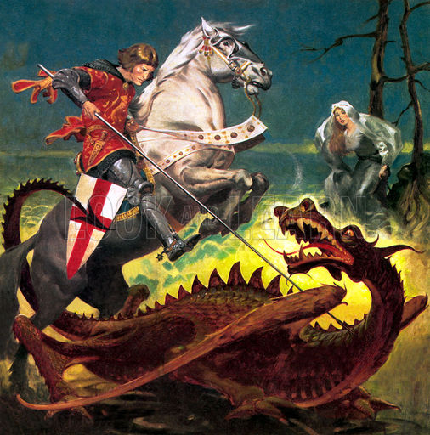
SIR HANS SLOANE'S BIRD Rev. GEORGE DE CHARMS NCL 1982
The teaching concerning Sir Hans Sloane's bird, recorded in Divine Love and Wisdom 344, is of tremendous importance to the New Church. It applies to all living creatures that have ever been created on the earth, and indicates how they are to be regarded as representative forms of use.

Slide 5
SIR HANS SLOANE'S BIRD Rev. GEORGE DE CHARMS NCL 1982
The teaching concerning Sir Hans Sloane's bird, recorded in Divine Love and Wisdom 344, is of tremendous importance to the New Church. It applies to all living creatures that have ever been created on the earth, and indicates how they are to be regarded as representative forms of use.

Slide 6
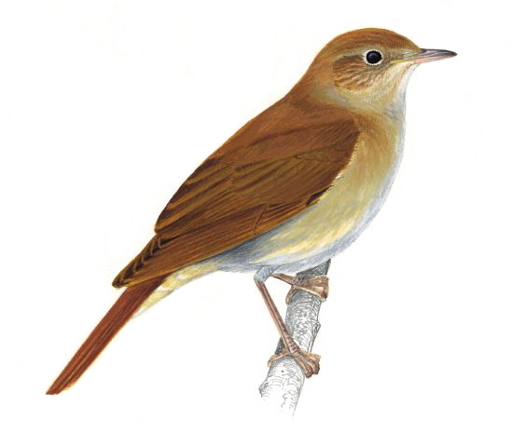
After quoting DLW 344 Bishop George deCharms continues:
It is the constant teaching of the Writings that material substances are not part of the living embodiment of any organism that is grown from seed. The function of the mineral kingdom is to clothe, fix and render permanent the real living body of any vegetable or animal creation. The real body of any living creature is a representative form of use.

Slide 7
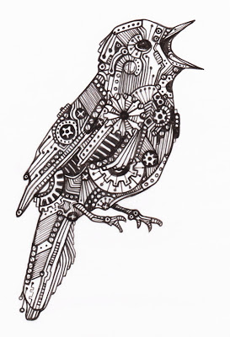
After quoting DLW 344 Bishop George deCharms continues:
It is the constant teaching of the Writings that material substances are not part of the living embodiment of any organism that is grown from seed. The function of the mineral kingdom is to clothe, fix and render permanent the real living body of any vegetable or animal creation. The real body of any living creature is a representative form of use.
If we identify the living organism with the material substances that clothe it, we fail to see the Divine purpose for which it is created. We regard it then as a marvelous mechanism that has no connection with the Divine Source of life. It conveys no message of love and wisdom from God to men, and performs no spiritual or eternal use to mankind.

Slide 8
Saint George and the Dragon

Slide 9
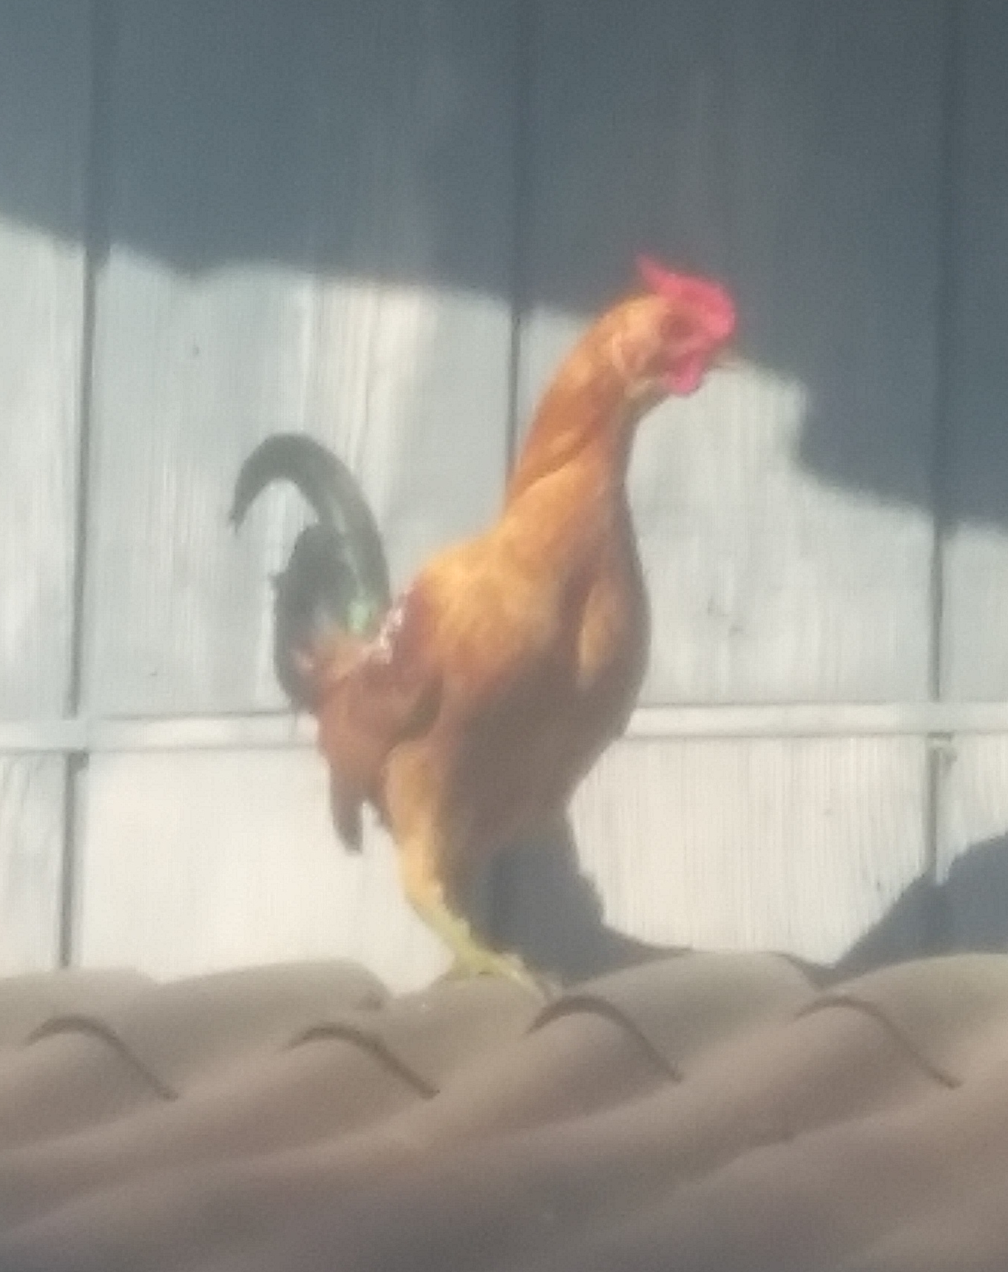
Enter Banty

Slide 10
AE 1218 All the objects in the spiritual world are similar [to those in the natural.] ... the things which are seen and felt there are not material, but substantial from a spiritual origin, and that they are notwithstanding still real, because they exist from the same origin as all the things in the natural world.
The only difference is that an additional covering, an over-garment, so to speak, from the sun of the world, has been given to the things which exist in the natural world, and from this they have become material, fixed, stated, and measurable.
I can positively affirm that the things which exist in the spiritual are even more real than those in the natural world; for that which in nature is added to the spiritual is dead, and does not produce reality, but diminishes it.

Slide 11
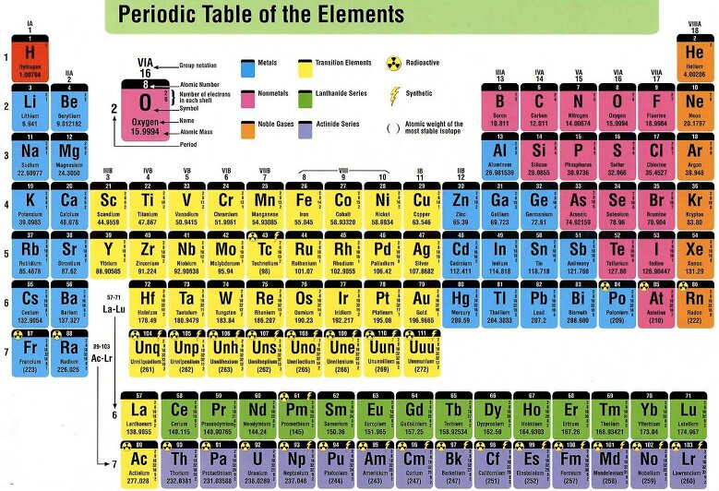
AE 1209 The mineral kingdom is simply a storehouse, in which are contained and from which are taken the things of which the forms of the other kingdoms, the animal and the vegetable, are composed.

Slide 12
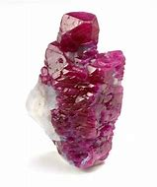
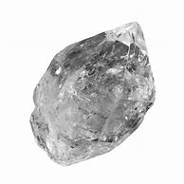
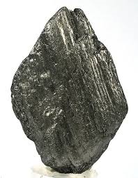
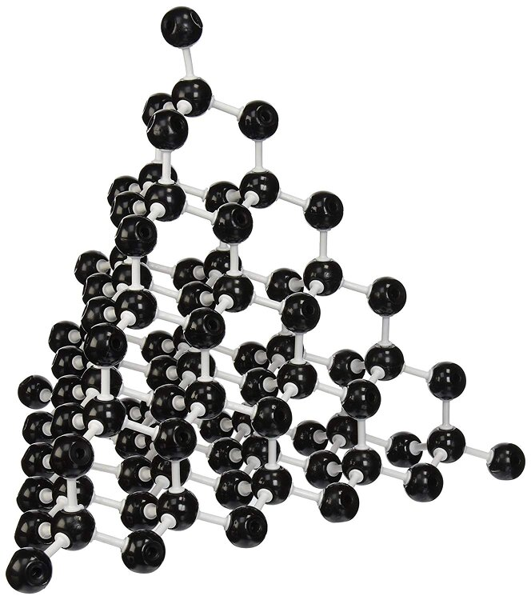
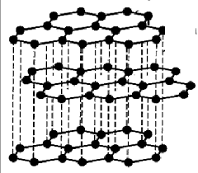
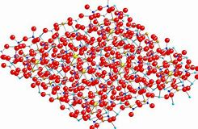
Ruby Diamond Graphite

Slide 13
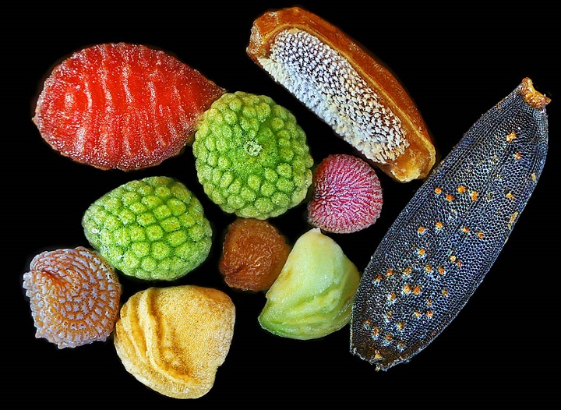
Seeing Wisdom in Nature - Divine Providence 3
That the universe, with each thing and all things of it, was created from the Divine love by means of the Divine wisdom can be confirmed by all things submitted to sight in the world. Select any particular object and examine it with some wisdom, and you will be convinced.

Slide 14
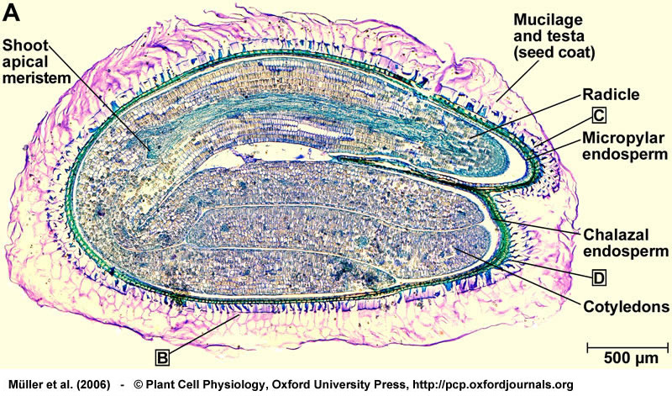
Seeing Wisdom in Nature - Divine Providence 3
That the universe, with each thing and all things of it, was created from the Divine love by means of the Divine wisdom can be confirmed by all things submitted to sight in the world. Select any particular object and examine it with some wisdom, and you will be convinced. Take a tree, or its seed, its fruit, its flower, or its leaf, gather up the wisdom that is in you, examine the object with a good microscope, and you will see wonderful things; while the interiors that you do not see are still more wonderful.

Slide 15
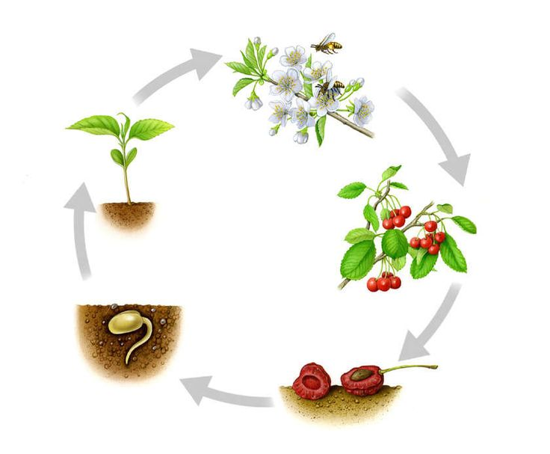
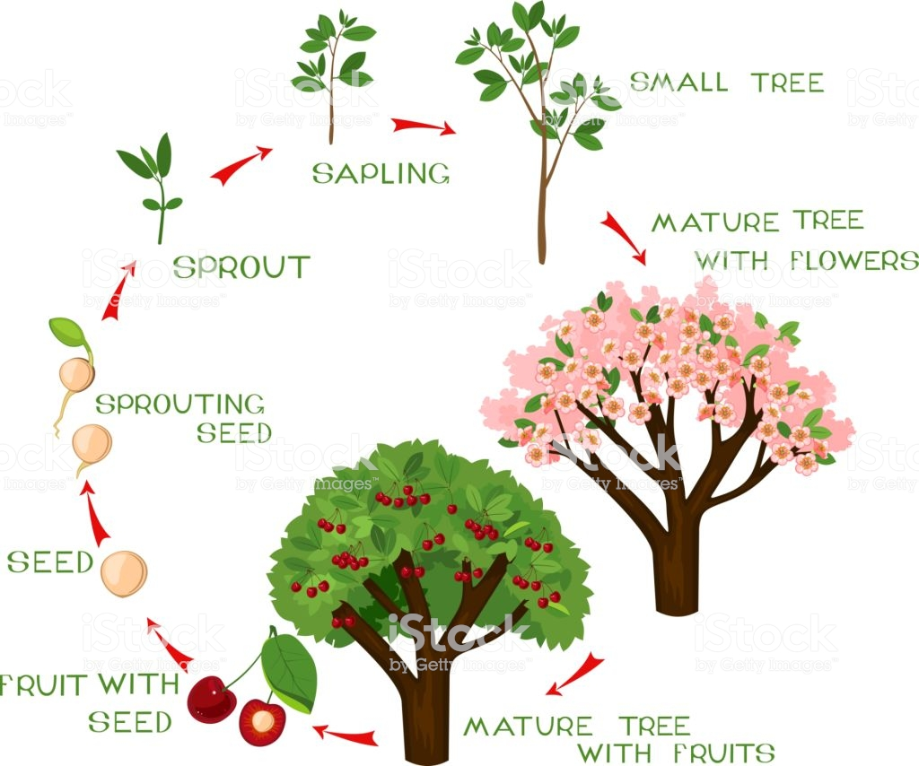
“Will you not now see Wisdom” - Divine Providence 3 cont.
Observe the order in its development, how the tree grows from seed even to new seed, and consider whether there is not at every successive step a continual endeavor to propagate itself further; for the final thing to which it aims is seed, in which its reproductive power exists anew. And if you are willing to think spiritually, which you can do if you wish, will you not now see wisdom here?

Slide 16
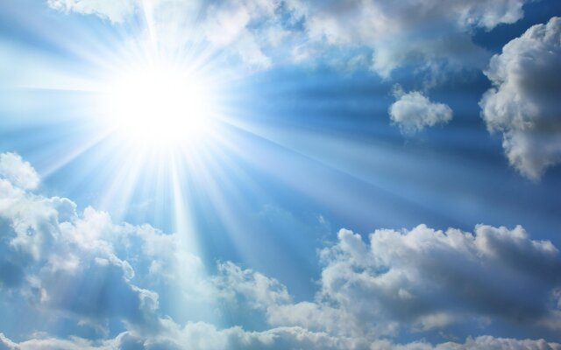
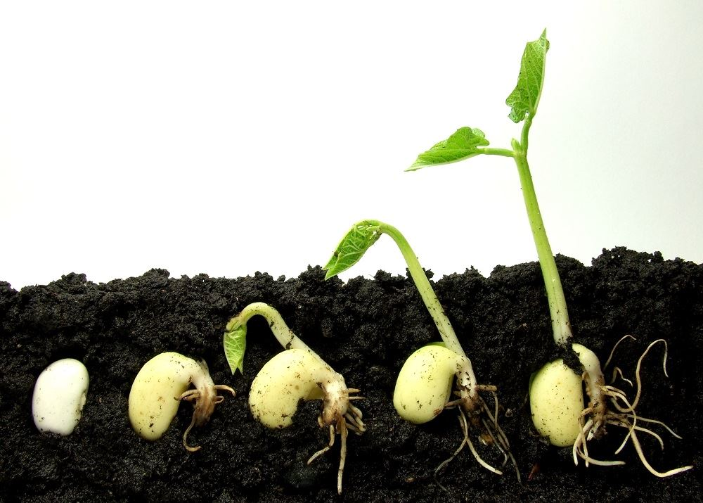
“If you are willing?” Divine Providence 3 cont.
Moreover, if you are willing to go far enough in spiritual thought, will you not see also that this power is not from the seed, nor from the sun of the world, which is pure fire, but is in the seed from God the Creator, whose wisdom is infinite; and in it not only at the moment it was created, but continually afterwards? For conservation is perpetual creation, as subsistence is perpetual existence or coming forth.

Slide 17
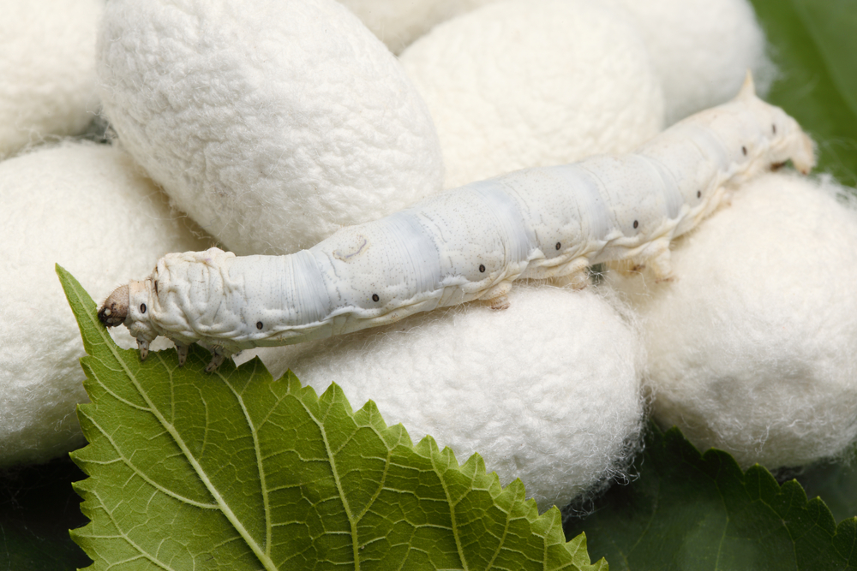
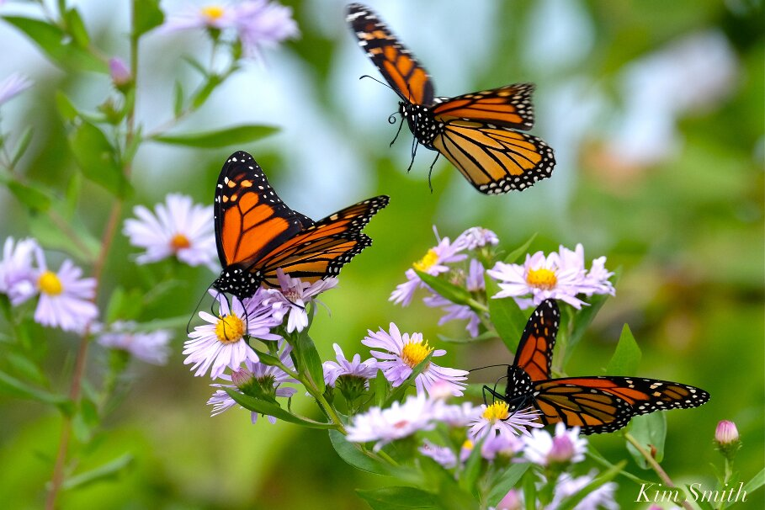
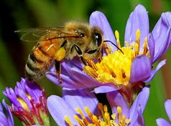
“Who can fail to see the Divine?” Divine Providence 3 cont.
In fact, every such created thing is endowed with power; but power acts not from itself, but from Him who bestowed the power. Examine any other object on the earth, as a silkworm, a bee, or any other little creature; look at it first naturally, afterwards rationally, and at length spiritually, and if you are able to think deeply, you will be astonished at it all; and if you will let wisdom speak within you, you will say in amazement, “Who can fail to see the Divine in these things? All things are of the Divine wisdom.”

Slide 18
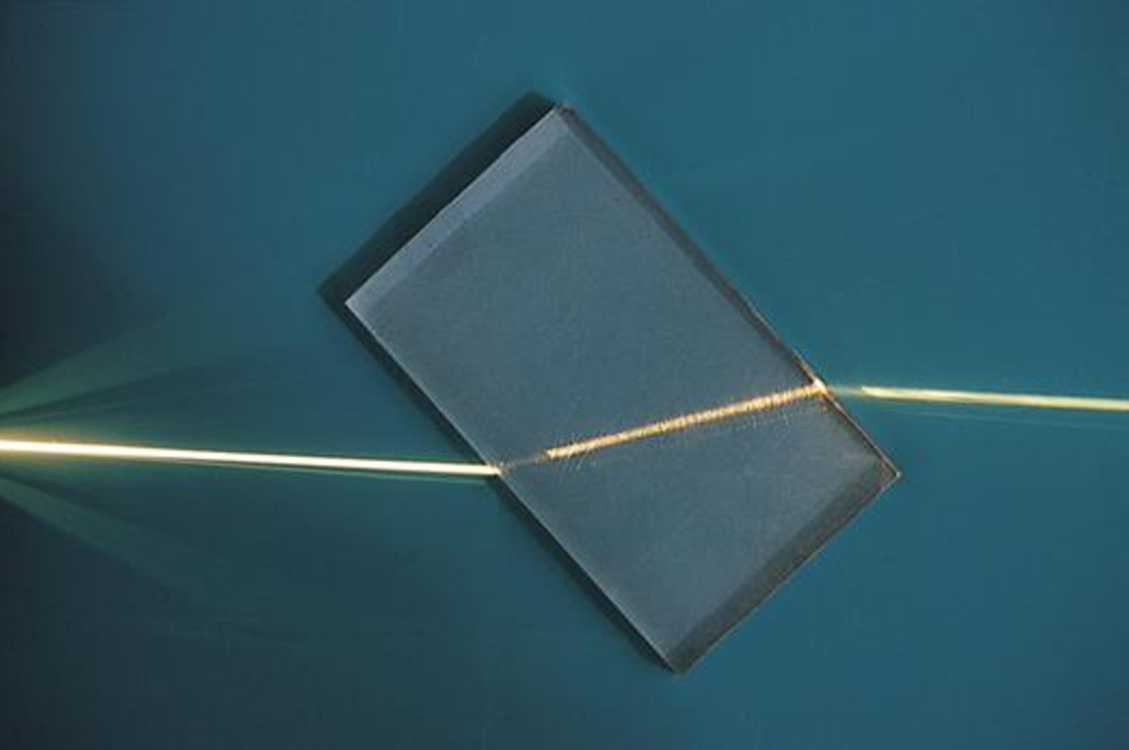
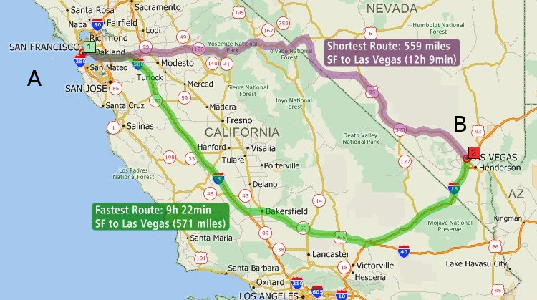
The Principle of Least Action by Louis Maupertuis - 1744
Now I have to define what I mean by "action". When a material body is transported from one point to another, it involves an action that depends on the speed of the body and on the distance it travels. However, the action is neither the speed nor the distance taken separately; rather, it is proportional to the sum of the distances traveled multiplied each by the speed at which they traveled. Hence, the action increases linearly with the speed of the body and with the distance traveled. This action is the true expense of Nature, which she manages to make as small as possible in the motion of light.
B
B
B
A

Slide 19
B
A

Slide 21
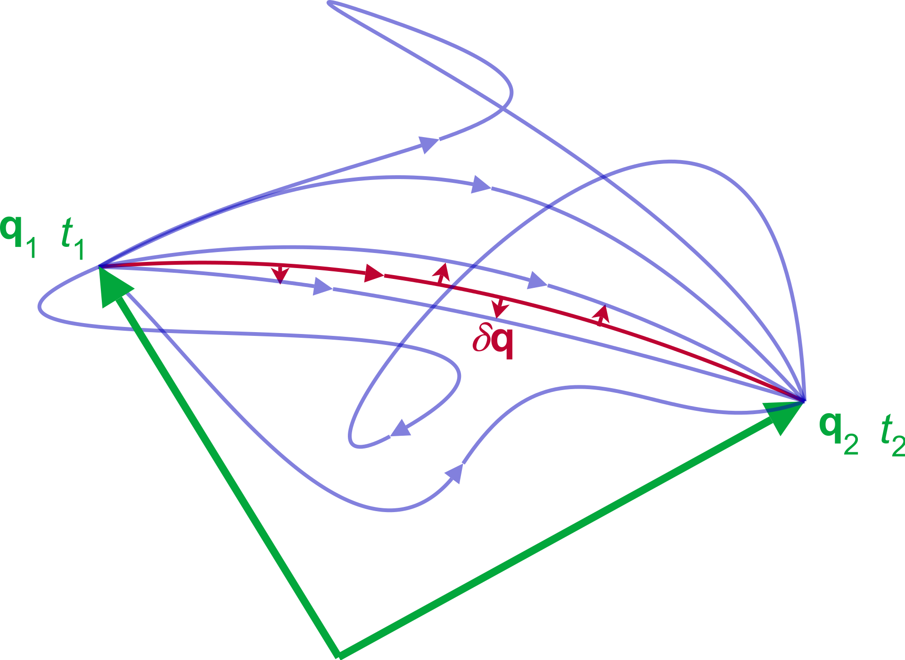
The wisdom of God - Maupertuis
One cannot doubt that everything is governed by a supreme Being who has imposed forces on material objects, forces that show His power, just as he has fated those objects to execute actions that demonstrate His wisdom. ... To unify the certainty of our research with its breadth, it is necessary to use both types of study. Let us calculate the motion of bodies, but also consult the plans of the Intelligence that makes them move.
It seems that the ancient philosophers made the first attempts at this sort of science, in looking for metaphysical relationships between numbers and material bodies. When they said that God occupies himself with geometry, they surely meant that He unites in that science the works of His power with the perspectives of His wisdom.

Slide 22
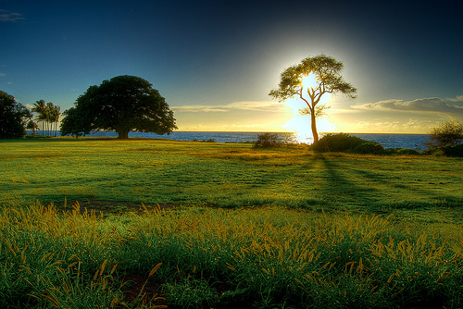
Opening our eyes – DLW 46
Thought from the eye closes the understanding, but thought from the understanding opens the eye. (DLW 46).
Faith is the eye of love (AC 3863:12).
The necessity of the affirmative principle. (AC 127-129, 2568, 2588, 6047, etc.).

Slide 23
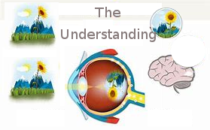
How the eye sees AE 1146:4
The sensory of sight, which is the eye, sees objects out of itself as if it were close by them, when, in fact, the rays of light convey with wings of ether their forms and colors into the eye, and these forms when perceived in the eye are observed by an internal sight that is called the understanding, and are distinguished and recognized according to their quality. ... The five bodily sensories by virtue of an influx from within are sensible of what flows in from outside; the influx from within is from the spiritual world, and the influx from outside is from the natural world.

Slide 24
The four laws inscribed on the nature of all things. AE 1146
With all this the laws inscribed on the nature of all things are in harmony, which laws are:

Slide 25
The four laws inscribed on the nature of all things. AE 1146
With all this the laws inscribed on the nature of all things are in harmony, which laws are:
(1) That nothing exists or subsists from itself, or is acted upon or moved by itself, but only by something else. From this it follows that everything exists and subsists and is acted upon and moved by the First that is not from another, but is in itself the living force, which is life.

Slide 26
The four laws inscribed on the nature of all things. AE 1146
With all this the laws inscribed on the nature of all things are in harmony, which laws are:
(1) That nothing exists or subsists from itself, or is acted upon or moved by itself, but only by something else. From this it follows that everything exists and subsists and is acted upon and moved by the First that is not from another, but is in itself the living force, which is life.
(2) That nothing can be acted upon or moved unless it is intermediate between two forces, one of which acts and the other reacts, that is, unless one acts on the one side and the other on the other, and unless one acts from within and the other from without.

Slide 27
The four laws inscribed on the nature of all things. AE 1146
With all this the laws inscribed on the nature of all things are in harmony, which laws are:
(1) That nothing exists or subsists from itself, or is acted upon or moved by itself, but only by something else. From this it follows that everything exists and subsists and is acted upon and moved by the First that is not from another, but is in itself the living force, which is life.
(2) That nothing can be acted upon or moved unless it is intermediate between two forces, one of which acts and the other reacts, that is, unless one acts on the one side and the other on the other, and unless one acts from within and the other from without.
(3) And since these two forces when at rest produce an equilibrium, it follows that nothing can be put in action or moved unless it is in equilibrium, and when put in action it is out of the equilibrium; also that everything put in action or moved seeks to return to an equilibrium.

Slide 28
The four laws inscribed on the nature of all things. AE 1146
With all this the laws inscribed on the nature of all things are in harmony, which laws are:
(1) That nothing exists or subsists from itself, or is acted upon or moved by itself, but only by something else. From this it follows that everything exists and subsists and is acted upon and moved by the First that is not from another, but is in itself the living force, which is life.
(2) That nothing can be acted upon or moved unless it is intermediate between two forces, one of which acts and the other reacts, that is, unless one acts on the one side and the other on the other, and unless one acts from within and the other from without.
(3) And since these two forces when at rest produce an equilibrium, it follows that nothing can be put in action or moved unless it is in equilibrium, and when put in action it is out of the equilibrium; also that everything put in action or moved seeks to return to an equilibrium.
(4) That all activities are changes of state and variations of form, and that the latter are from the former.

Slide 29
There are three forces in all of creation: The active, the creative and the formative.
AE 1209 The active force, because it is spiritual, proceeds from the fountain of all forces, which is the sun of heaven, and that is the Lord's Divine love, and love is the active itself, from which the living force which is life proceeds.

Slide 30
There are three forces in all of creation: The active, the creative and the formative.
AE 1209 The active force, because it is spiritual, proceeds from the fountain of all forces, which is the sun of heaven, and that is the Lord's Divine love, and love is the active itself, from which the living force which is life proceeds.
TCR 472 The following things are not creatable, namely:
(1) The infinite is not.
(2) Love and wisdom are not.
(3) Consequently life is not.
(4) Light and heat are not.
(5) Even activity itself viewed in itself is not.

Slide 31
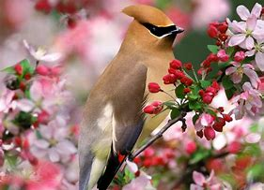
The Creative Force - Correspondences
The creative force is the force that produces causes and effects from beginning to end, and reaches from the First through intermediates to the last. The First is the sun of heaven itself, which is the Lord; intermediates are things spiritual, afterwards things natural, also things terrestrial, from which finally are productions.
And as in the creation of the universe that force proceeded from the First to the last, so afterwards it proceeds in like manner in order that productions may be continual; otherwise they would fail.

Slide 32
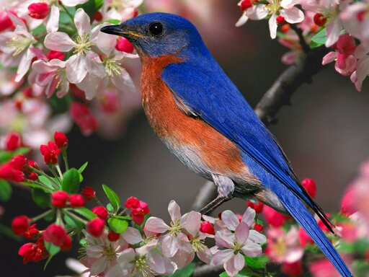
The Creative Force - Correspondences
The creative force is the force that produces causes and effects from beginning to end, and reaches from the First through intermediates to the last. The First is the sun of heaven itself, which is the Lord; intermediates are things spiritual, afterwards things natural, also things terrestrial, from which finally are productions.
And as in the creation of the universe that force proceeded from the First to the last, so afterwards it proceeds in like manner in order that productions may be continual; otherwise they would fail. For the First continually regards the last as an end; and unless the First looked to the last continually from itself through intermediates according to the order of creation, all things would perish; therefore productions, which are especially animals and plants, are continuations of creation.
It does not matter that the continuations are effected by seeds, it is still the same creative force that produces. Moreover, it is according to the observation of some that certain seeds are yet being produced.

Slide 33
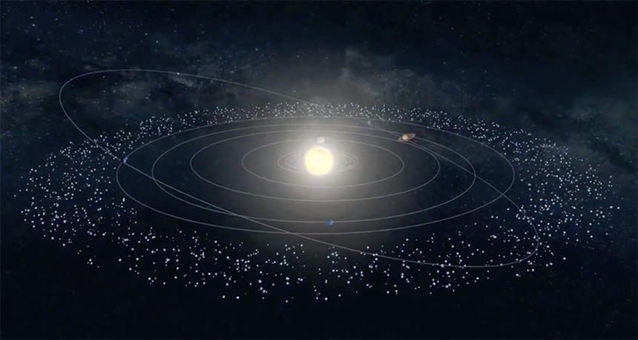
The formative force – physical forces

Slide 34
The formative force – physical forces
[4] The formative force is the last force from ultimates, for it is the force that produces animals and plants from the ultimate materials of nature, which are collected in the earth. The forces that are in nature from its origin, which is the sun of the world, are not living forces but dead forces. These do not differ from the forces of heat in man and animal, which keep the body in such a state that the will by means of affection, and the under- standing by means of thought, which are spiritual, can flow in and do their work in it. They do not differ from the forces of light in the eye, which simply cause the mind, which is spiritual, to see by means of its organ, the eye. The light of the world sees nothing, but the mind by the light of heaven. The same is true of plants.

Slide 35
The formative force – physical forces
[4] The formative force is the last force from ultimates, for it is the force that produces animals and plants from the ultimate materials of nature, which are collected in the earth. The forces that are in nature from its origin, which is the sun of the world, are not living forces but dead forces. These do not differ from the forces of heat in man and animal, which keep the body in such a state that the will by means of affection, and the under- standing by means of thought, which are spiritual, can flow in and do their work in it. They do not differ from the forces of light in the eye, which simply cause the mind, which is spiritual, to see by means of its organ, the eye. The light of the world sees nothing, but the mind by the light of heaven. The same is true of plants.
He who believes that the heat and light of the sun of the world do anything more than open and dispose the things proper to nature that they may receive influx from the spiritual world is very much deceived. (AE 1209)

Slide 37
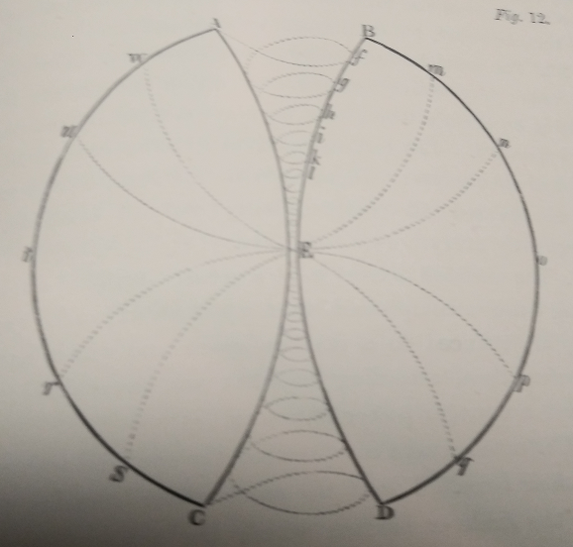
Swedenborg's five elements in the Principia
The universal element which constitutes vortices such as the solar vortex

Slide 38
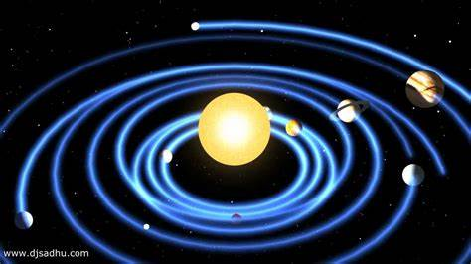
Swedenborg's five elements in the Principia
The universal element which constitutes vortices such as the solar vortex

Slide 39
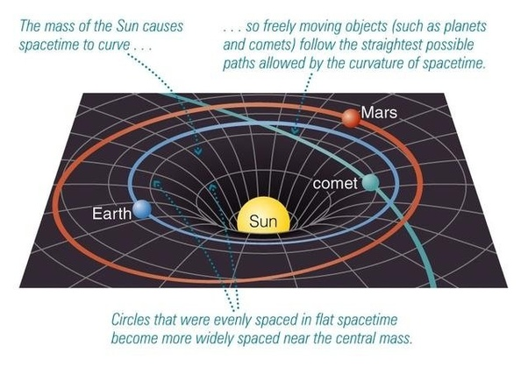
Swedenborg's five elements in the Principia
The universal element which constitutes vortices such as the solar vortex
Which is similar to the modern idea of curved space and gravity wells around the stars

Slide 40
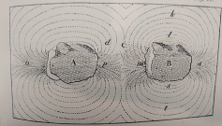
Swedenborg's five elements in the Principia
The universal element or Gravity
The second element or Magnetism

Slide 41
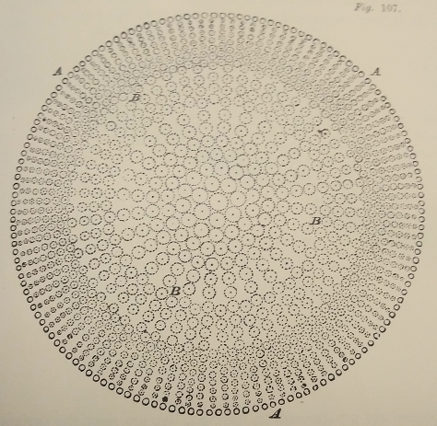
Swedenborg's five elements in the Principia
The universal element or Gravity
The second element or Magnetism
The third element or Ether

Slide 42
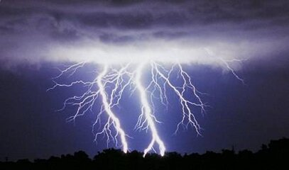
Swedenborg's five elements in the Principia
The universal element or Gravity
The second element or Magnetism
The third element or Ether
From the chapter on Ether number 21 we read:
“The ether is urged into a whirling motion at a distance from its body, and this causes light, and to a certain degree, electrity.”

Slide 43
Swedenborg's five elements in the Principia
The universal element or Gravity
The second element or Magnetism
The third element or Ether (Light, Electricity)
The fourth element or Air

Slide 44
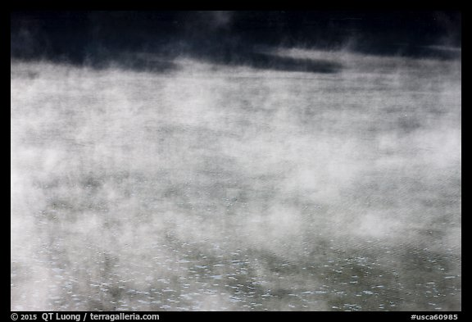
Swedenborg's five elements in the Principia
The universal element or Gravity
The second element or Magnetism
The third element or Ether (Light, Electricity)
The fourth element or Air
The fifth element or Water Vapor

Slide 45
Four Natural Spheres - SD 222
There are four natural spheres arising from the sun.
The atmosphere which produces hearing is known;
A purer atmosphere separate from the aerial is that which produces sight or visual images by the wonderful reflections of all objects.
Another atmosphere - the still purer ether - is that which produces the forces of magnets, which reign not only about the magnet in particular, but also about the whole globe, but there is no need to describe to what extent.
The purest ethereal sphere is the one that is universal in the whole world, …
These spheres are of the sun, and may be called solar, and thus natural.

Slide 46
Four Natural Spheres - SD 222
There are four natural spheres arising from the sun.
The atmosphere which produces hearing is known; [AIR]
A purer atmosphere separate from the aerial is that which produces sight or visual images by the wonderful reflections of all objects. [ETHER AND LIGHT]
Another atmosphere - the still purer ether - is that which produces the forces of magnets, which reign not only about the magnet in particular, but also about the whole globe, but there is no need to describe to what extent. [MAGNETISM]
The purest ethereal sphere is the one that is universal in the whole world, … [GRAVITY?]
These spheres are of the sun, and may be called solar, and thus natural.

Slide 47
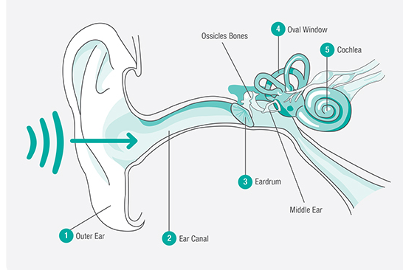
The secrets of Air and Ether inscribed on the Ear and the Eye
Everyone who has any knowledge of air and sound may know that the ear is formed in precise adaptation to the nature of their modifications, thus that in respect to its bodily and material form, the ear corresponds to them;

Slide 48
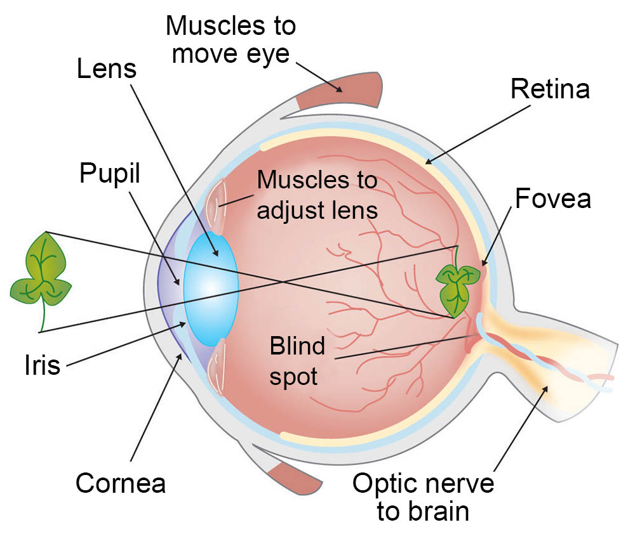
The secrets of Air and Ether inscribed on the Ear and the Eye
Everyone who has any knowledge of air and sound may know that the ear is formed in precise adaptation to the nature of their modifications, thus that in respect to its bodily and material form, the ear corresponds to them;
and he who has acquired any knowledge of the ether and light, knows that in respect to its bodily and material form, the eye has been formed so as to correspond to the modifications of these;

Slide 49
The secrets of Air and Ether inscribed on the Ear and the Eye
Everyone who has any knowledge of air and sound may know that the ear is formed in precise adaptation to the nature of their modifications, thus that in respect to its bodily and material form, the ear corresponds to them;
and he who has acquired any knowledge of the ether and light, knows that in respect to its bodily and material form, the eye has been formed so as to correspond to the modifications of these;
and that this is so much the case that whatever secret thing has been stored up in the nature of air and of sound is inscribed on the organism of the ear, and whatever secret thing has been stored up in the nature of the ether and of light is inscribed on the organism of the eye. AC 5423

Slide 50
The three natural atmospheres or ethers (Last Judgment Posthumous 320)
There are three natural atmospheres arising from the sun of the world, and there are three spiritual atmospheres arising from the sun of heaven, which is the Lord. The three natural atmospheres arising from the sun of the world are
the purer ether, which is universal, from which is all gravitation;
the middle ether, which forms the vortex around the planets, in which are the moons and the satellites, from which is magnetism;
and the ultimate ether which is the air.
By these three atmospheres all the corporeal and material things of the earth are held together, which are so composed as to be applicable to those three degrees.

Slide 51
How atmospheres become matter as they decrease in activity.
There are three atmospheres both in the spiritual and in the natural world, which are distinct from each other according to degrees of height, and which, in their progress toward lower things, decrease [in activity] according to degrees of breadth. (DLW 302)
Celestial
Spiritual
Natural
--------
Gravity
Light, Electro-Magnetism
Air

Slide 52
How atmospheres become matter as they decrease in activity.
And since atmospheres in their progress toward lower things decrease [in activity], it follows that they constantly become more compressed and inert, and finally, in outmosts, become so compressed and inert as to be no longer atmospheres, but substances at rest, and in the natural world, fixed like those in the lands that are called matters. (DLW 302)
Celestial Goods
Spiritual Truths
Natural Uses
--------
Gravity Masses?
Light, EM Waves
Air Particles

Slide 53
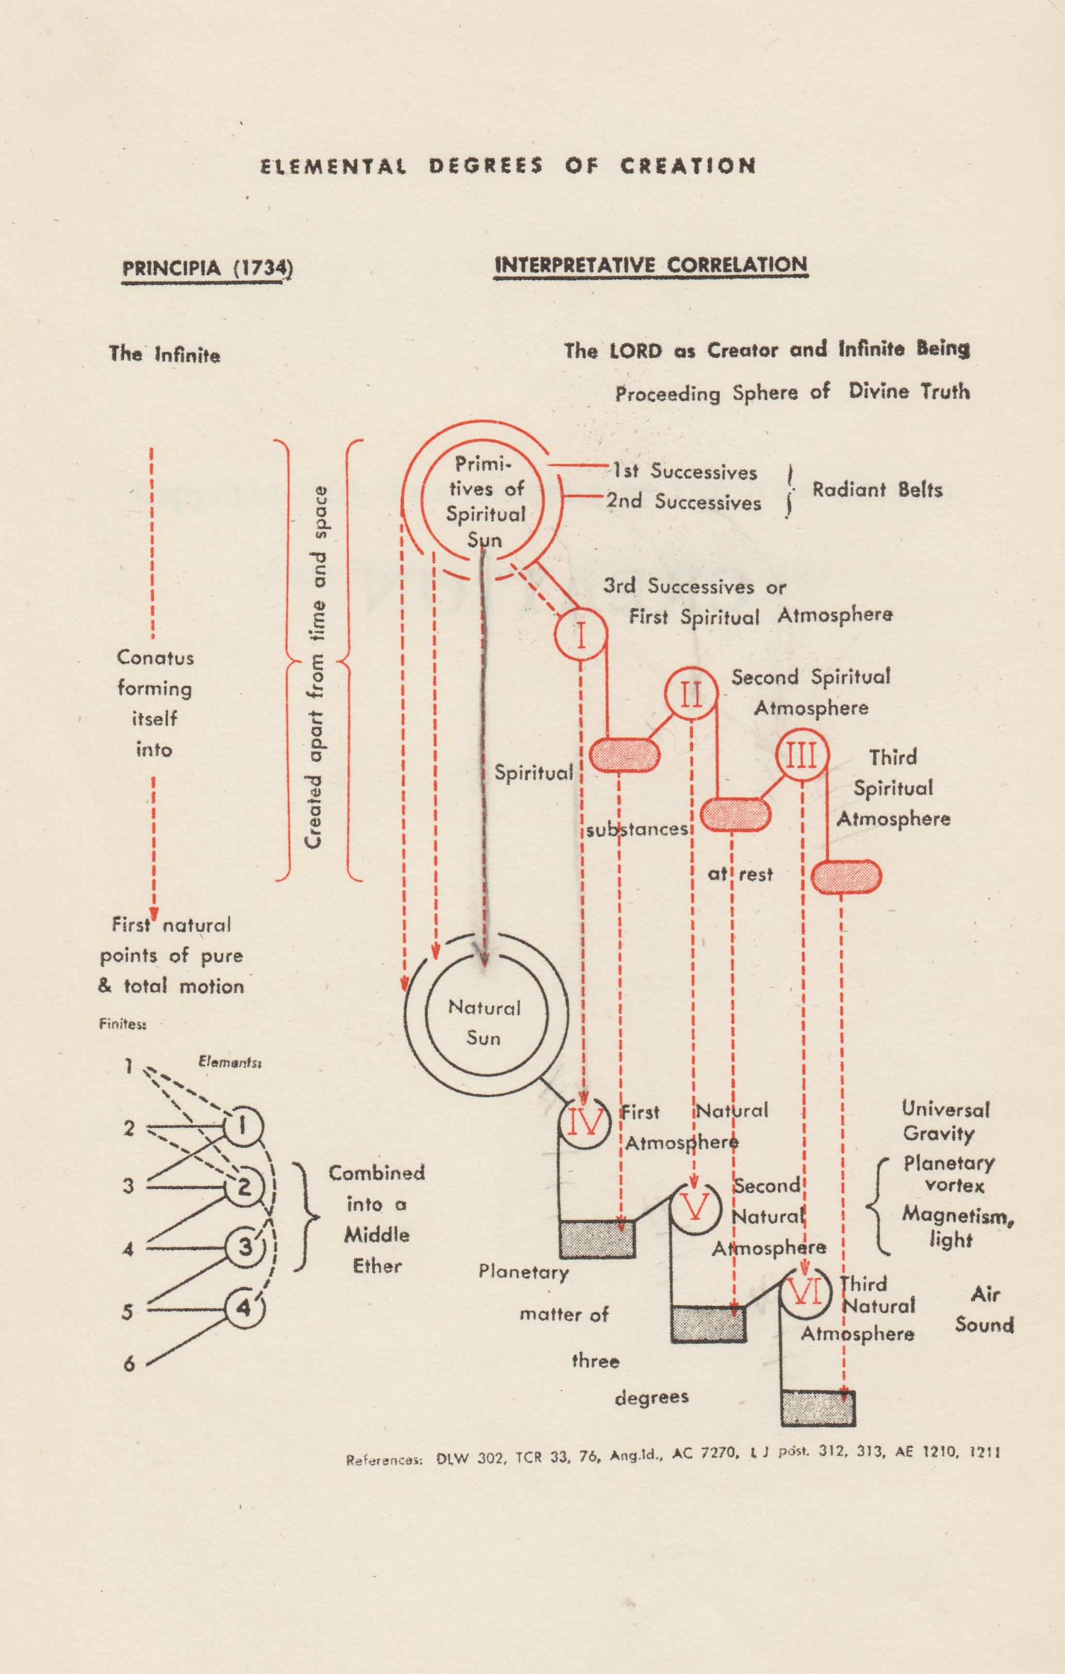
How atmospheres become matter as they decrease in activity.
As such is the origin of substances and matters, it follows,
first, that these substances and matters also are of three degrees;
secondly, that they are held together in mutual connection by encompassing atmospheres;
thirdly, that they are fitted for the production of all uses in their forms. (DLW 302)

Slide 54
Three atmospheres or elements both spiritual and natural (Coronis 17)
Since every perfect thing must be a trine and cohere well together, in order to be a one, therefore each world, both spiritual and natural, consists and subsists from three atmospheres or elements;
the first of which immediately encompasses the sun and is called aura;
the second is under this and is called ether;
and the third is under them both and is called air.
In the natural world these three atmospheres are natural, and in themselves passive, because they proceed from a sun which is pure fire; but the three corresponding to them in the spiritual world are spiritual, and in themselves active, because they proceed from a sun which is pure love.

Slide 55
The difference between the three spiritual degrees in the spiritual world, and the three spiritual degrees when fixed by the three physical degrees.
LJP 321 But it should be known, that the atmospheres arising from the sun of heaven,
which is the Lord, properly speaking, are not three, but six, there are three above the sun
of the world, and there are three below it. The three below the sun of the world
constantly accompany the three natural atmospheres, and enable a man in the natural
world to think and to feel. For the atmospheres arising from the sun of the world have
not life in themselves, because they originate from a sun which is pure fire; but the
atmospheres arising from the sun of heaven, which is the Lord, have life in themselves,
because they originate in the sun, which is pure love and pure wisdom. The atmospheres
which originate from the sun of the world, which is pure fire, cause those things on the
earth, and in the human body, to subsist and be held in connection together, and they are
not changed except according to the laws of natural order. Hence is the difference
between things in the natural world and in the spiritual world.

Slide 56
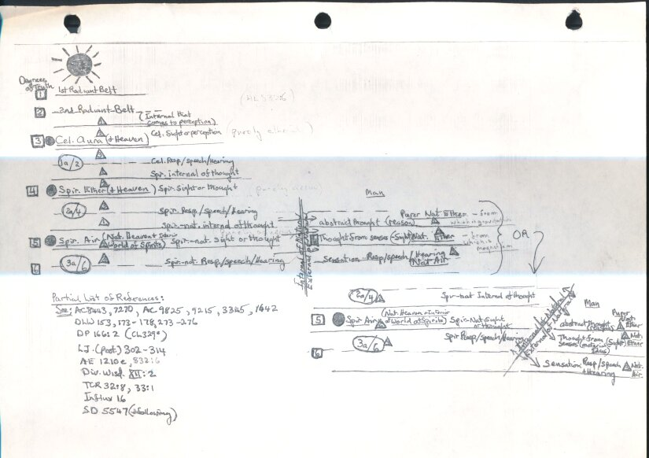

Slide 57
Conclusion
From this teaching it would seem that the spiritual atmospheres above the natural sun have a formative force in the spiritual world, thus their forms are spiritual, and can come and go with the spiritual states of those in the spiritual world. But the atmospheres from the spiritual sun which are below the natural sun, are spiritual atmospheres (or creative forces) inflowing into the physical atmospheres (formative forces) propagating and conserving the physical forms which give them fixity and presence in the natural world.

